Slide 1
NETW191 Course Project Module 5 Visio Network Diagram

Slide 2
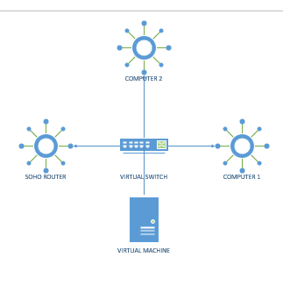
Microsoft Visio Network Diagram
This diagram should illustrate the interconnection of the Computer 1 VM, the Computer 2 VM, and the SOHO Router VM.

